Slide 1
Topic 5: Discovering Requirements (Part 1)
SECV2113 Human-Computer Interaction
Faculty of Computing
Universiti Teknologi Malaysia

Slide 2
WHAT, HOW AND WHY?
01
WHAT ARE REQUIREMENTS?
02
DATA GATHERING FOR REQUIREMENTS
03
BRINGING REQUIREMENTS TO LIFE: PERSONAS AND SCENARIOS
04
CAPTURING INTERACTION WITH USE CASES
04

Slide 3
WHAT, HOW,
& WHY?

Slide 4
What, How?
What is the purpose of the requirements activity?
Explore the problem space
Establish the design challenge to be addressed
How can requirements be captured once discovered
In prototypes or operational product
Through structured or rigorous notations
Criteria to show when requirements are fulfilled
Different physical and digital representations emphasise and de-emphasise different aspects

Slide 5
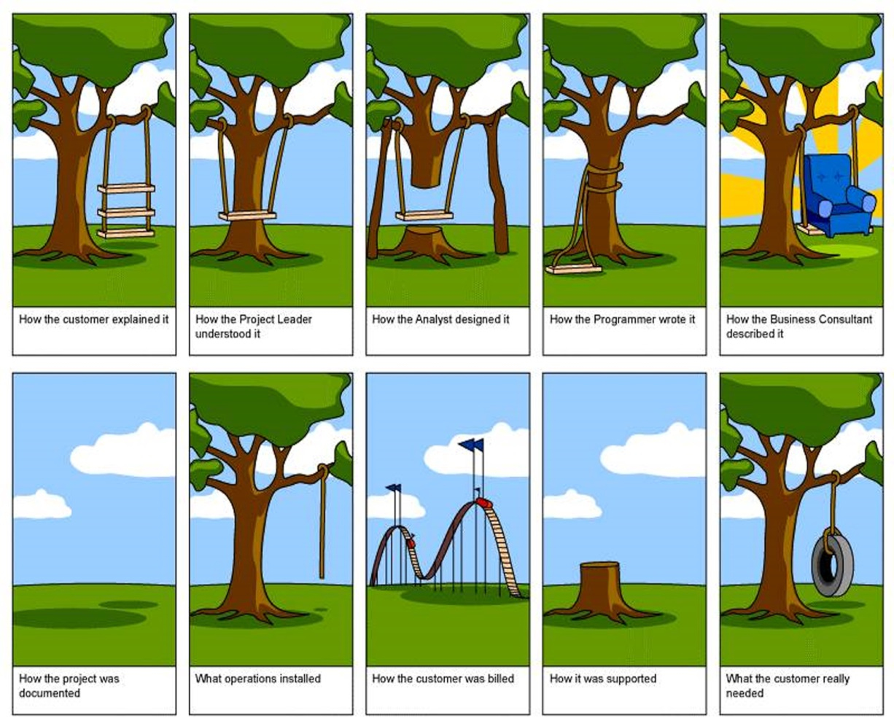
Why are requirements important?
Requirements activity is the stage where miscommunication occurs most commonly

Slide 6
WHAT ARE
REQUIREMENTS?

Slide 7
What are Requirements?
A statement about an intended product that specifies what it is expected to do or how it will perform
Different forms and different levels of abstraction
User stories (prevalent in agile development contexts)
Format:
As a <role>, I want <behavior> so that <benefit>
Example user stories for a travel organiser might be:
As a <traveler>, I want <to save my favorite airline for all my flights> so that <I will be able to collect air miles>
As a <travel agent>, I want <my special discount rates to be displayed to me> so that <I can offer my clients competitive rates>

Slide 8
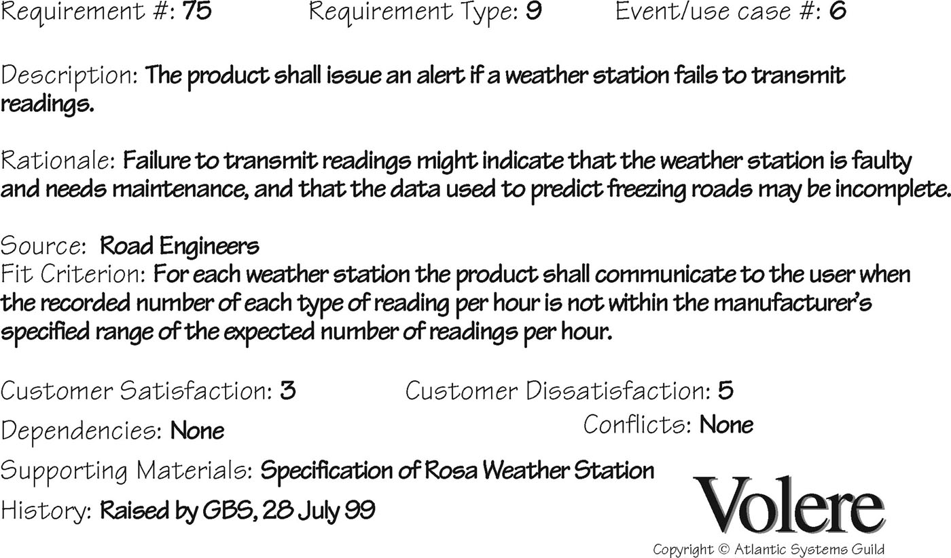
Volere Shell

Slide 9
Different kinds of Requirements
Functional:
What the system should do
Data:
What kinds of data need to be stored?
What are the characteristics of the data?

Slide 10
Different kinds of Requirements (Cont.)
Environment or context of use:
Physical: dusty? noisy? vibration? light? heat? humidity? …. (for example, in a hospital)
Social: collaboration and co-ordination, data sharing, distributed, synchronous or asynchronous, privacy
Support: user support, communications structure and infrastructure, availability of training
Technical: on which technologies will it run or with which it needs to be compatible?

Slide 11
Different kinds of Requirements (Cont.)
User characteristics — Who are they?
Characteristics: educational background, personal circumstances, abilities or skills
System use: novice, expert, casual, frequent
Novice: prompted, constrained, clear
Expert: flexibility, access/power
Frequent: shortcuts
Casual/infrequent: clear menu paths
User profile

Slide 12
Different kinds of Requirements (Cont.)
Usability goals
User experience goals
Different products have different requirements and may be implemented in different ways, for example, security

Slide 13
Usable Security
How to make security robust without detracting from user experience?
If the usability of security is ignored, then security mechanisms will be circumvented
What might affect usable security
Making security mechanisms visible or not
Sonification of password strength
Good design may have undesirable effect on security
Notes:
Circumvent - obstacle

Slide 14
The Seven Product Dimensions
Source: Gottesdiener and Gorman (2012), p.58. Used courtesy of Ellen Gottesdiener

Slide 15
DATA GATHERING FOR
REQUIREMENTS

Slide 16
Data Gathering for Requirements
Interviews, observation, and questionnaires
Studying documentation:
Procedures and rules are often written down in manuals
Good source of data about the steps involved in an activity and any regulations governing a task
Not to be used in isolation
Good for understanding legislation and getting background information
No stakeholder time, which is a limiting factor for other techniques
Researching similar products:
Good for prompting requirements

Slide 17
Combining Data Gathering
Direct observation, indirect observation, interviews, diaries, and surveys
Source: Hollis et al (2017), Figure 1. Used courtesy of Taylor and Francis

Slide 18
Combining Data Gathering
Diaries and interviews: multiple information devices
Interviews, think aloud evaluation, questionnaire, evaluation of working prototype: memory aid for traumatic brain injury
Studying documentation, evaluating other systems, user observation, and focus groups: ship’s maneuvering system
Questionnaire, focus group, design probe, and user study: smart meters for power consumption and privacy

Slide 19
Using Probes with Stakeholders
Many types of probe:
Designed to prompt stakeholders into action
For researchers to learn about participants
All rely on data logging: automatic or manual
Design probe:
Form relates specifically to particular question and context
Cultural probe:
Participants asked to answer questions using postcards, maps, camera, photo album, and diary
Technology probe:
A working prototype placed in an in-the-wild context
Provocative probe:
Designed to challenge existing norms and attitudes

Slide 20
Contextual Inquiry
Part of Contextual Design, and used on its own to discover requirements
One-on-one field interviews (contextual interviews)
1.5 to 2 hours long
Focus on daily life at home or work relevant to the project
Uses a model of master (participant) and apprentice (researcher)
Four main principles
Context: Going to the participant, wherever they are, and seeing what they do as they do it
Partnership: Participant & interviewer explore participant’s life together
Interpretation: Observations interpreted by participant & interviewer together
Focus: Project focus guides what should be paid attention to

Slide 21
Contextual Inquiry (Cont.)
Interview guided by “cool concepts” divided into two groups
Joy of life concepts:
How products make our lives richer and more fulfilling
Accomplish, connection, identity, and sensation
Joy of use concepts:
Describe impact of using the product
Direct in action, the hassle factor, and the learning delta
Interview in four parts
Overview, transition, main interview, and wrap-up
Following interview, interpretation session
Contextual design models are created or consolidated
Most relevant models are chosen by team, out of 10 suggested

Slide 22
Brainstorming for Innovation
Alex Osborn’s (1930s) four rules:
Quantity over quality
Criticisms should be withheld
Encourage out-of-the-box thinking
Combine, refine and improve ideas
Brainstorming requires careful facilitation

Slide 23
BRINGING
REQUIREMENTS
TO LIFE

Slide 24
Bringing Requirements to Life
Augmenting the basic requirements expressed as stories, in Volere template, or in other form
Personas
Characterises someone who might use the product, not specific people
Scenarios
An informal narrative story, simple, ‘natural’, personal, and not generalisable

Slide 25
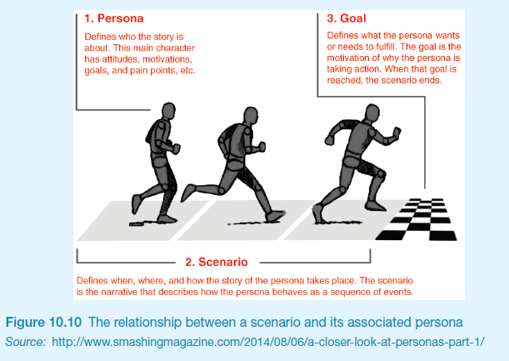
Scenarios and Personas

Slide 26
Personas
Capture a set of user characteristics (user profile)
Synthesised from real people based on research
Typical, not idealised
Bring to life with name, characteristics, goals, and personal background
Relevant to product under development
Good persona helps designer with design decisions and reminds team about who will use the product
Develop a small set of personas with one primary

Slide 27
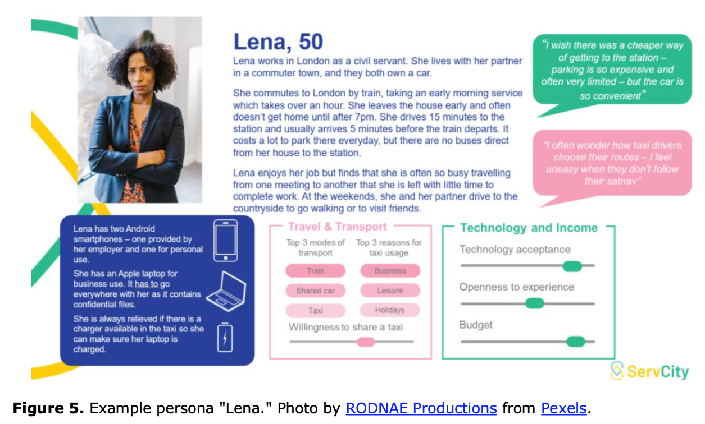
Example Persona #1

Slide 28
Example Persona #2
Developed using Xtensio Templates

Slide 29
Scenario for Group Travel Organiser
“The Thomson family enjoy outdoor activities and want to try their hand at sailing this year. There are four family members: Sky (8 years old), Eamonn (12 years old), Claire (32), and Will (35). One evening after dinner they decide to start exploring the possibilities. They want to discuss the options together but Claire has to visit her elderly mother so will be joining the conversation from her mother’s house down the road. As a starting point, Will enters an idea they had been discussing over dinner – a sailing trip for four novices in the Mediterranean. The system supports users to log on from different locations and use different devices so that all members of the family can interact easily and comfortably with it wherever they are. The system's initial suggestion is a flotilla, where several crews (with various levels of experience) sail together on separate boats. Sky and Eamonn aren't very happy at the idea of going on vacation with a group of other people, even though the Thomson’s would have their own boat. The travel organizer shows them descriptions of flotillas from other children their ages and they are all very positive, so eventually, everyone agrees to explore flotilla opportunities. Will confirms this recommendation and asks for detailed options. As it's getting late, he asks for the details to be saved so everyone can consider them tomorrow. The travel organizer messages them a summary of the different options available.”

Slide 30
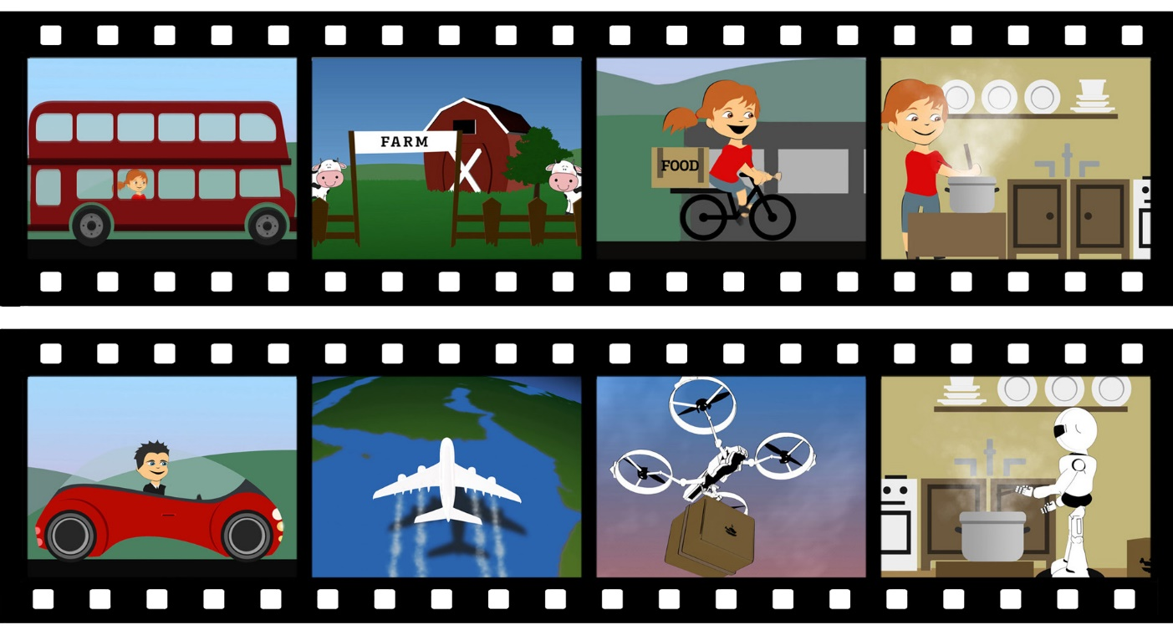
Scenarios
May be textual descriptions, animations, audio or video
Example animation scenarios
Source: Tommy Nilsson, et al (2020) Visions, Values, and Videos: Revisiting Envisionings in Service of UbiComp Design for the Home, DIS ‘20: Pages 827–839
ACM Publications.

Slide 31
Design Fiction
Communicate a vision with future technologies
Fictional world in which ethics, emotions, and context can be explored without concrete constraints
Examples:
Privacy and surveillance
Exploring ethics
Scenarios are about “overcoming the monster,” while design fiction is about “quest”

Slide 32
CAPTURING
INTERACTION USING
USE CASES

Slide 33
Use Cases
Focus on functional requirements and capture interaction
Can be used in design or to capture requirements
Use cases are step-by-step descriptions of interactions
Two styles:
Essential use cases: division of tasks, no implementation detail
Use case with normal and alternative courses: more detail

Slide 34
Example Essential Use Case for Travel Organiser
retrieveVisa
USER INTENTION SYSTEM RESPONSIBILITY
Find visa requirements
Request destination and nationality
Supply required information
Obtain appropriate visa info
Obtain copy of visa info
Offer info in different formats
Choose suitable format
Provide info in chosen format
Note: The user intention and system responsibility are offset vertically, showing a sequence of interactions

Slide 35
Use Case for Travel Organiser
The product asks for the name of the destination country
The user provides the country’s name
The product checks that the country is valid
The product asks the user for their nationality
The user provides their nationality
The product checks the visa requirements of that country for a passport holder of the user’s nationality
The product provides the visa requirements
The product asks whether the user wants to share the visa requirements on social media
The user provides appropriate social media information

Slide 36
Alternative Courses for Travel Organiser
Some alternative courses:
4. If the country name is invalid:
4.1: The product provides an error message
4.2: The product returns to step 1
6. If the nationality is invalid:
6.1: The product provides an error message
6.2: The product returns to step 4
7. If no information about visa requirements is found:
7.1: The product provides a suitable message
7.2: The product returns to step 1

Slide 37
Summary
A requirement is a statement about an intended product that specifies what it is expected to do or how it will perform.
Articulating requirements avoids miscommunication, supports technical developers and allows stakeholders to contribute.
Different kinds of requirements: functional, data, environmental (context of use), user characteristics, usability goals, and user experience goals.
Scenarios are a story-based narrative to explore existing behavior, potential of new products, and futuristic visions of use.
Personas capture realistic profiles of people who might use the product and are synthesized from data gathering.
Scenarios and personas can be used together throughout the product lifecycle.
Use cases capture details about an existing or imagined interaction between users and the product.

